Slide 1
10.2.2 Two-Factor CIR Model
報告人: 汪文豪
報告日期: 2023.08.08

Slide 2
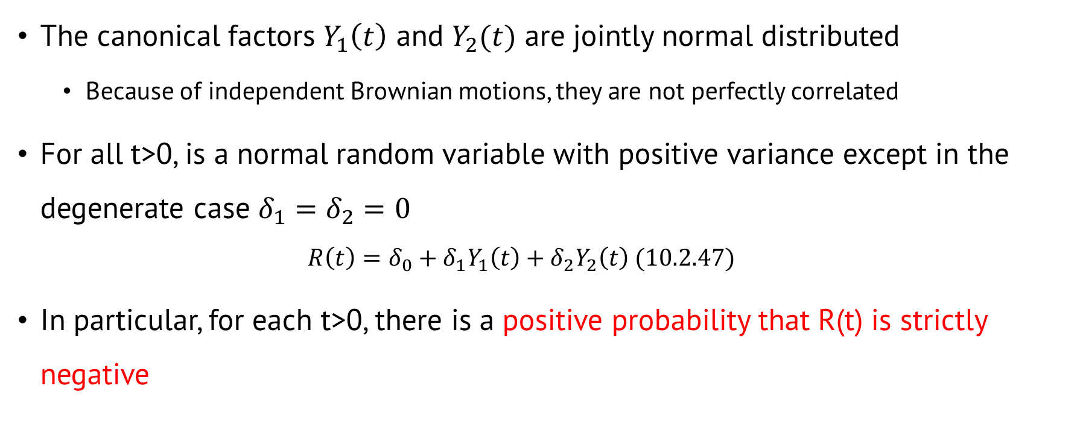
Two-factor Vasicek model
The canonical factors $Y_{1}\left(t\right)$ and $Y_{2}(t)$ are jointly normal distributed
Because of independent Brownian motions, they are not perfectly correlated
For all t>0, is a normal random variable with positive variance except in the degenerate case $δ_{1}=δ_{2}=0$
$$R\left(t\right)=δ_{0}+δ_{1}Y_{1}\left(t\right)+δ_{2}Y_{2}\left(t\right) (10.2.47)$$
In particular, for each t>0, there is a positive probability that R(t) is strictly negative

Slide 3

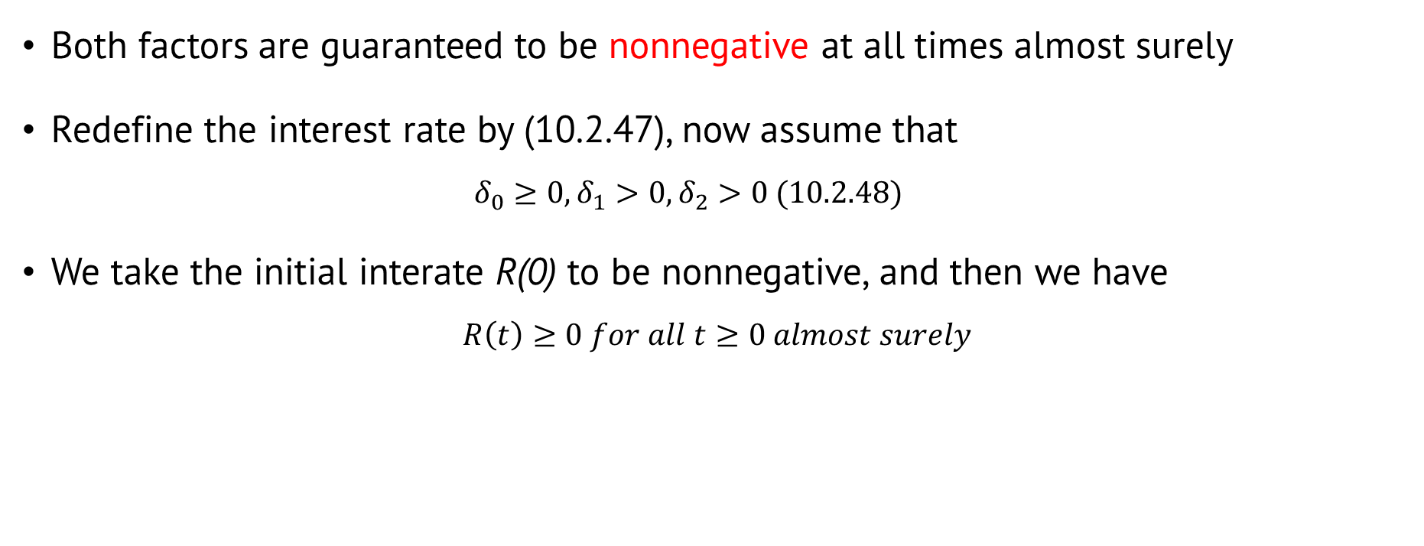
Two-Factor Cox-Ingersoll-Ross model (CIR)
Both factors are guaranteed to be nonnegative at all times almost surely
Redefine the interest rate by (10.2.47), now assume that
$$δ_{0}≥0, δ_{1}>0, δ_{2}>0 (10.2.48)$$
We take the initial interate R(0) to be nonnegative, and then we have $R\left(t\right)≥0 for all t≥0 almost surely$
$$R\left(t\right)=δ_{0}+δ_{1}Y_{1}\left(t\right)+δ_{2}Y_{2}\left(t\right) (10.2.47)$$
remove degenerate case

Slide 4

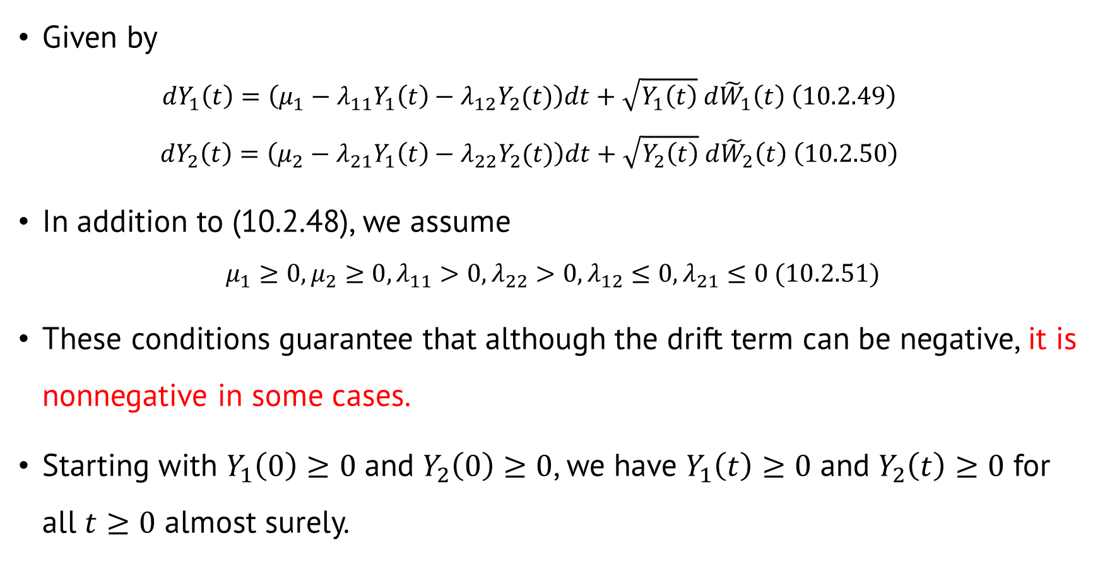


The evolution of the factor processes
Given by
$$dY_{1}\left(t\right)=\left(μ_{1}−λ_{11}Y_{1}\left(t\right)−λ_{12}Y_{2}(t)\right)dt+\sqrt{Y_{1}\left(t\right)} d{\tilde{W}}_{1}\left(t\right) \left(10.2.49\right)$$
$$dY_{2}\left(t\right)=\left(μ_{2}−λ_{21}Y_{1}\left(t\right)−λ_{22}Y_{2}(t)\right)dt+\sqrt{Y_{2}\left(t\right)} d{\tilde{W}}_{2}\left(t\right) \left(10.2.50\right)$$
In addition to (10.2.48), we assume
$$μ_{1}≥0, μ_{2}≥0, λ_{11}>0,λ_{22}>0,λ_{12}≤0,λ_{21}≤0 (10.2.51)$$
These conditions guarantee that although the drift term can be negative, it is nonnegative in some cases.
Starting with $Y_{1}\left(0\right)≥0$ and $Y_{2}\left(0\right)≥0$, we have $Y_{1}\left(t\right)≥0$ and $Y_{2}\left(t\right)≥0$ for all $t≥0$ almost surely.
Whenever $Y_{1}\left(t\right)=0 and Y_{2}\left(t\right)≥0$
Whenever $Y_{2}\left(t\right)=0 and Y_{1}\left(t\right)≥0$
$$δ_{0}≥0, δ_{1}>0, δ_{2}>0 (10.2.48)$$

Slide 5

Zero-coupon bond prices in the two-factor CIR model
As in the two-factor Vasicek model, the price at time t of a zero-coupon bond maturing at a later time T must be of the form for some function $f\left(t, y_{1}, y_{2}\right)$ $B\left(t, T\right)=f(t, Y_{1}\left(t\right), Y_{2}\left(t\right))$

Slide 6
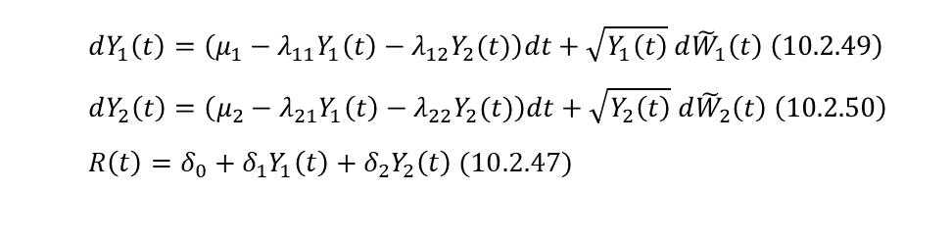
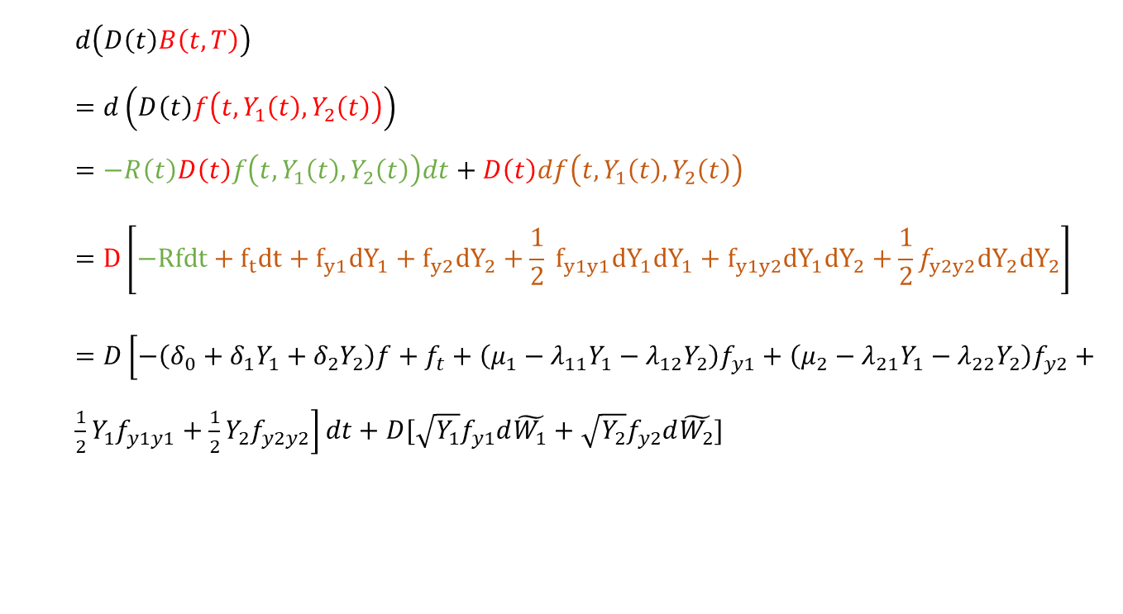
The discounted bond price has differential
$$d\left(D\left(t\right)B\left(t,T\right)\right) \\ =d\left(D\left(t\right)f\left(t,Y_{1}\left(t\right),Y_{2}\left(t\right)\right)\right) \\ =−R\left(t\right)D\left(t\right)f\left(t,Y_{1}\left(t\right),Y_{2}\left(t\right)\right)dt+D\left(t\right)df\left(t,Y_{1}\left(t\right), Y_{2}\left(t\right)\right) \\ =D\left[−Rfdt+f_{t}dt+f_{y1}{dY}_{1}+f_{y2}{dY}_{2}+\frac{1}{2} f_{y1y1}{dY}_{1}{dY}_{1}+f_{y1y2}{dY}_{1}{dY}_{2}+\frac{1}{2}f_{y2y2}{dY}_{2}{dY}_{2}\right]$$ $=D\left[−\left(δ_{0}+δ_{1}Y_{1}+δ_{2}Y_{2}\right)f+f_{t}+\left(μ_{1}−λ_{11}Y_{1}−λ_{12}Y_{2}\right)f_{y1}+\left(μ_{2}−λ_{21}Y_{1}−λ_{22}Y_{2}\right)f_{y2}+\frac{1}{2}Y_{1}f_{y1y1}+\frac{1}{2}Y_{2}f_{y2y2}\right]dt+D[\sqrt{Y_{1}}f_{y1}d\tilde{W_{1}}+\sqrt{Y_{2}}f_{y2}d\tilde{W_{2}}]$
$$dY_{1}\left(t\right)=\left(μ_{1}−λ_{11}Y_{1}\left(t\right)−λ_{12}Y_{2}(t)\right)dt+\sqrt{Y_{1}\left(t\right)} d{\tilde{W}}_{1}\left(t\right) \left(10.2.49\right)$$
$$dY_{2}\left(t\right)=\left(μ_{2}−λ_{21}Y_{1}\left(t\right)−λ_{22}Y_{2}(t)\right)dt+\sqrt{Y_{2}\left(t\right)} d{\tilde{W}}_{2}\left(t\right) \left(10.2.50\right) \\ R\left(t\right)=δ_{0}+δ_{1}Y_{1}\left(t\right)+δ_{2}Y_{2}\left(t\right) (10.2.47)$$

Slide 7
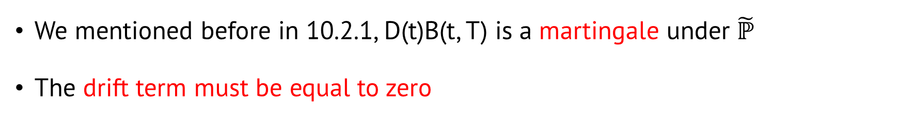

We mentioned before in 10.2.1, D(t)B(t, T) is a martingale under $\tilde{ℙ}$
The drift term must be equal to zero
$$D\left[−\left(δ_{0}+δ_{1}Y_{1}+δ_{2}Y_{2}\right)f+f_{t}+\left(μ_{1}−λ_{11}Y_{1}−λ_{12}Y_{2}\right)f_{y1}+\left(μ_{2}−λ_{21}Y_{1}−λ_{22}Y_{2}\right)f_{y2}+\frac{1}{2}Y_{1}f_{y1y1}+\frac{1}{2}Y_{2}f_{y2y2}\right]dt$$ $+D[\sqrt{Y_{1}}f_{y1}d\tilde{W_{1}}+\sqrt{Y_{2}}f_{y2}d\tilde{W_{2}}]$
Then we obtain the partial differential equation 10.2.52 for all $t∈\left[0, T\right) and all y_{1}≥0, y_{2}≥0$
$$−\left(δ_{0}+δ_{1}Y_{1}+δ_{2}Y_{2}\right)f+f_{t}+\left(μ_{1}−λ_{11}Y_{1}−λ_{12}Y_{2}\right)f_{y1}+\left(μ_{2}−λ_{21}Y_{1}−λ_{22}Y_{2}\right)f_{y2}+\frac{1}{2}Y_{1}f_{y1y1}+\frac{1}{2}Y_{2}f_{y2y2}=0 (10.2.52)$$

Slide 8
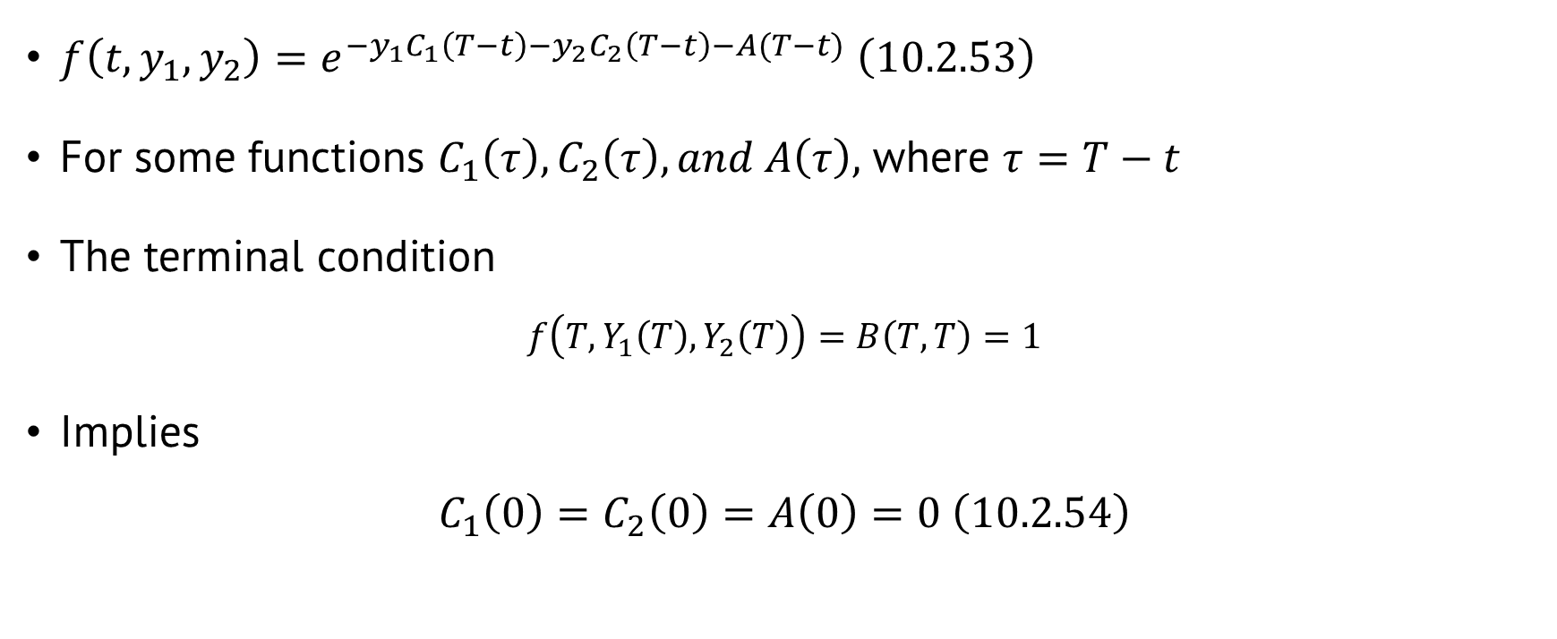
Seek a solution of the affine-yield form
$f\left(t,y_{1},y_{2}\right)=e^{−y_{1}C_{1}\left(T−t\right)−y_{2}C_{2}\left(T−t\right)−A(T−t)} \left(10.2.53\right)$
For some functions $C_{1}\left(τ\right), C_{2}\left(τ\right), and A\left(τ\right),$ where $τ=T−t$
The terminal condition
$$f\left(T,Y_{1}\left(T\right), Y_{2}\left(T\right)\right)=B\left(T, T\right)=1$$
Implies $C_{1}\left(0\right)=C_{2}\left(0\right)=A\left(0\right)=0 \left(10.2.54\right)$

Slide 9

With ‘ denoting differentiation with respect to $τ$, we have $\frac{d}{dt}C_{i}\left(τ\right)=−C_{i}^{′}\left(τ\right), i=1,2, \frac{d}{dt}A\left(τ\right)=−A′(τ)$
$$−\left(δ_{0}+δ_{1}Y_{1}+δ_{2}Y_{2}\right)f+f_{t}+\left(μ_{1}−λ_{11}Y_{1}−λ_{12}Y_{2}\right)f_{y1}+\left(μ_{2}−λ_{21}Y_{1}−λ_{22}Y_{2}\right)f_{y2}+\frac{1}{2}Y_{1}f_{y1y1}+\frac{1}{2}Y_{2}f_{y2y2}=0 (10.2.52)$$
$$\left[\left(C_{1}^{′}+λ_{11}C_{1}+λ_{21}C_{2}+\frac{1}{2}C_{1}^{2}−δ_{1}\right)y1+\left(C_{2}^{′}+λ_{12}C_{1}+λ_{22}C_{2}+\frac{1}{2}C_{2}^{2}−δ_{2}\right)y2+\left(A^{′}−μ_{1}C_{1}−μ_{2}C_{2}−δ_{0}\right)\right]f=0 (10.2.55)$$

Slide 10
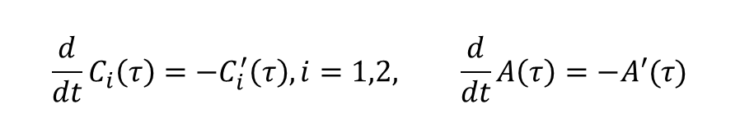
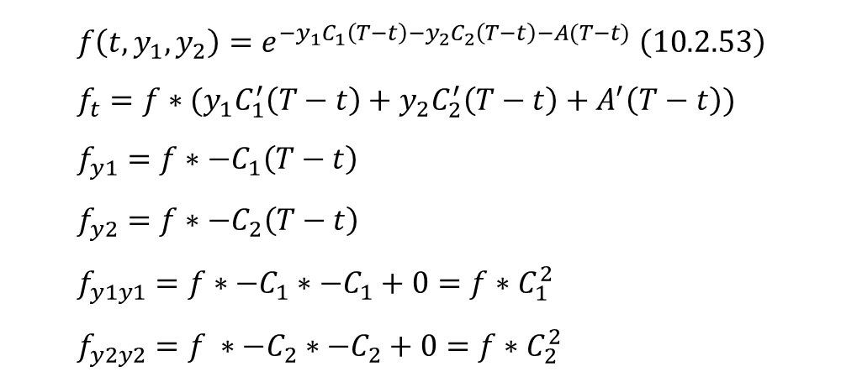
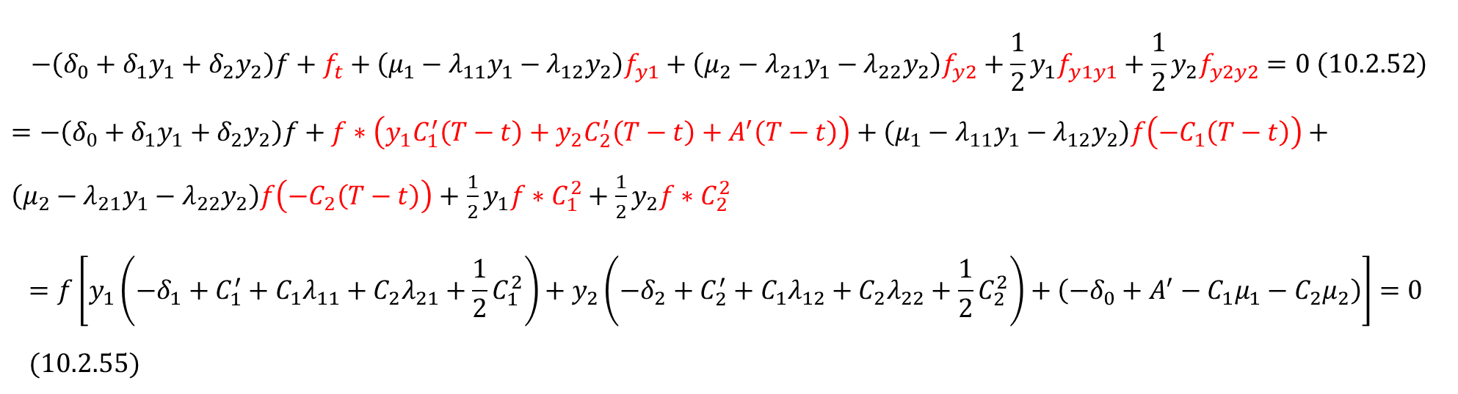
$$\frac{d}{dt}C_{i}\left(τ\right)=−C_{i}^{′}\left(τ\right), i=1,2, \frac{d}{dt}A\left(τ\right)=−A′(τ)$$
$$f\left(t,y_{1},y_{2}\right)=e^{−y_{1}C_{1}\left(T−t\right)−y_{2}C_{2}\left(T−t\right)−A(T−t)} \left(10.2.53\right) \\ f_{t}=f∗(y_{1}C_{1}^{′}\left(T−t\right)+y_{2}C_{2}^{′}\left(T−t\right)+A^{′}\left(T−t\right)) \\ f_{y1}=f∗−C_{1}\left(T−t\right) \\ f_{y2}=f∗−C_{2}\left(T−t\right) \\ f_{y1y1}=f∗−C_{1}∗−C_{1}+0=f∗C_{1}^{2} \\ f_{y2y2}=f ∗−C_{2}∗−C_{2}+0=f∗C_{2}^{2}$$
$$−\left(δ_{0}+δ_{1}y_{1}+δ_{2}y_{2}\right)f+f_{t}+\left(μ_{1}−λ_{11}y_{1}−λ_{12}y_{2}\right)f_{y1}+\left(μ_{2}−λ_{21}y_{1}−λ_{22}y_{2}\right)f_{y2}+\frac{1}{2}y_{1}f_{y1y1}+\frac{1}{2}y_{2}f_{y2y2}=0 \left(10.2.52\right)$$ $=−\left(δ_{0}+δ_{1}y_{1}+δ_{2}y_{2}\right)f+f∗\left(y_{1}C_{1}^{′}\left(T−t\right)+y_{2}C_{2}^{′}\left(T−t\right)+A^{′}\left(T−t\right)\right)+\left(μ_{1}−λ_{11}y_{1}−λ_{12}y_{2}\right)f\left(−C_{1}\left(T−t\right)\right)+\left(μ_{2}−λ_{21}y_{1}−λ_{22}y_{2}\right)f\left(−C_{2}\left(T−t\right)\right)+$ $\frac{1}{2}y_{1}f∗C_{1}^{2}+\frac{1}{2}y_{2}f∗C_{2}^{2}$ $$=f\left[y_{1}\left(−δ_{1}+C_{1}^{′}+C_{1}λ_{11}+C_{2}λ_{21}+\frac{1}{2}C_{1}^{2}\right)+y_{2}\left(−δ_{2}+C_{2}^{′}+C_{1}λ_{12}+C_{2}λ_{22}+\frac{1}{2}C_{2}^{2}\right)+\left(−δ_{0}+A^{′}−C_{1}μ_{1}−C_{2}μ_{2}\right)\right]=0 \\ (10.2.55)$$

Slide 11

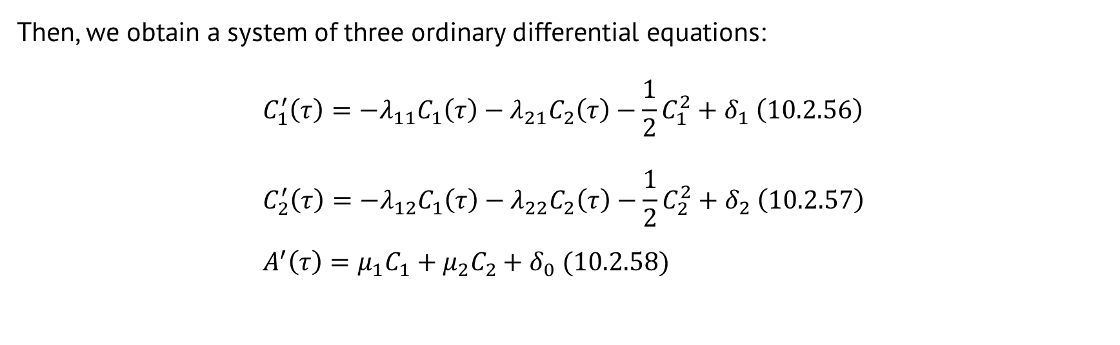
Like we mentioned (10.2.52), (10.2.55) must hold for all $y_{1}≥0 and y_{2}≥0$
$$\left[\left(C_{1}^{′}+λ_{11}C_{1}+λ_{21}C_{2}+\frac{1}{2}C_{1}^{2}−δ_{1}\right)y1+\left(C_{2}^{′}+λ_{12}C_{1}+λ_{22}C_{2}+\frac{1}{2}C_{2}^{2}−δ_{2}\right)y2+\left(A^{′}−μ_{1}C_{1}−μ_{2}C_{2}−δ_{0}\right)\right]f=0 (10.2.55)$$
The three terms must be zero.
Then, we obtain a system of three ordinary differential equations:
$$C_{1}^{′}\left(τ\right)=−λ_{11}C_{1}\left(τ\right)−λ_{21}C_{2}\left(τ\right)−\frac{1}{2}C_{1}^{2}+δ_{1} \left(10.2.56\right) \\ C_{2}^{′}\left(τ\right)=−λ_{12}C_{1}\left(τ\right)−λ_{22}C_{2}\left(τ\right)−\frac{1}{2}C_{2}^{2}+δ_{2} \left(10.2.57\right) \\ A^{′}\left(τ\right)=μ_{1}C_{1}+μ_{2}C_{2}+δ_{0} (10.2.58)$$
The solution to these equations satisfying the initial condition (10.2.54) can be found numerically.
$$C_{1}\left(0\right)=C_{2}\left(0\right)=A\left(0\right)=0 \left(10.2.54\right)$$

Slide 12
Thanks for listening

